Slide 1
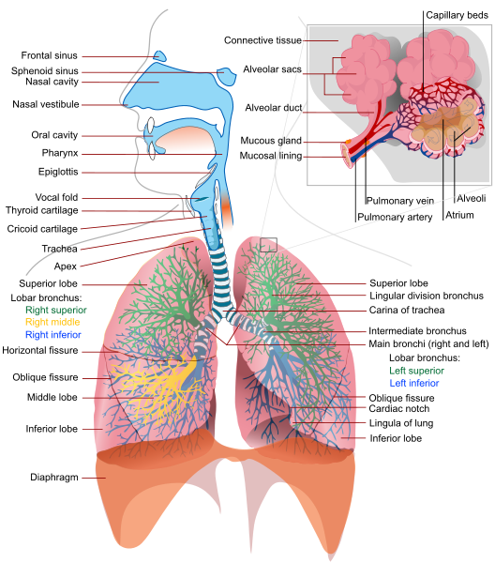
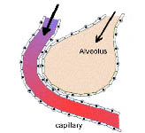
01 Pulmonary Assessment
Perfusion – movement of blood through the lungs
Ventilation: Movement of air in and out of lungs
Diffusion: ability of oxygen to move from avioli to blood stream and vise versa
Notes:
Hmo

Slide 2
Obstructive Lung Disease
Can’t get air OUT b/c of “things”
Restrictive Lung Disease
Can’t get air IN b/c of scaring
Asthma: chronic inflammatory disease of the airways characterized by variable and recurring symptoms, reversible airflow obstruction, and bronchospasm.
If reversible: bronchodilators will increase FEV1 by 12%
COPD: Emphysema and Chronic Bronchitis
Emphysema: Damaged air sacs (ALVEOLI)
Definition: physical shape and function of the lungs are destroyed
Cause: Smoking, air pollution
2. Chronic Bronchitis: Damaged AIRWAY
Definition: Mucus. increased number (hyperplasia) and increased size (hypertrophy) of the goblet cells and mucous glands of the airway
Cause:
Intrinsic Lung disease
Interstitial fibrosis
Pneumonia
Sarcoidosis
Lung cancer
Extrinsic Lung disease
Thoracis (spine)
Abdominal
Neuromuscular (weak muscles including diphram)

Slide 3
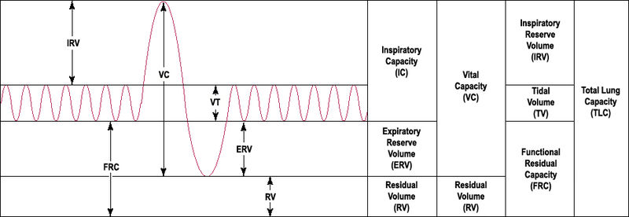
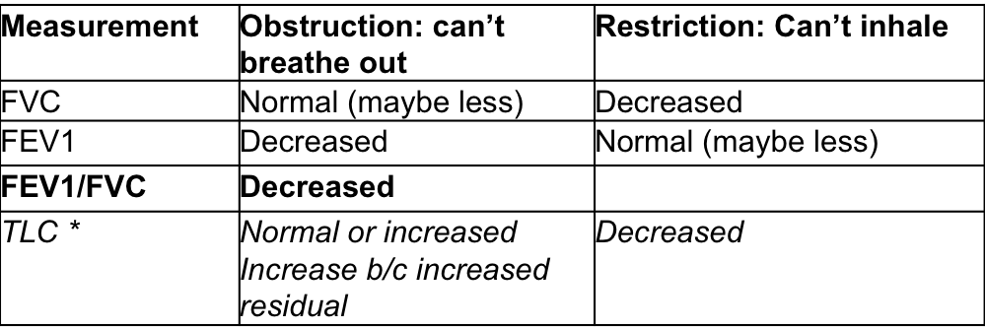
  VC is 70% of total lung capacity
  FEV1/FVC is a specific measure of airway obstruction VC1/VC
  Normally the ratio is 75-80% or greater
  Values < 75% suggest obstruction
  Usually measured pre and post bronchodilators

Slide 4
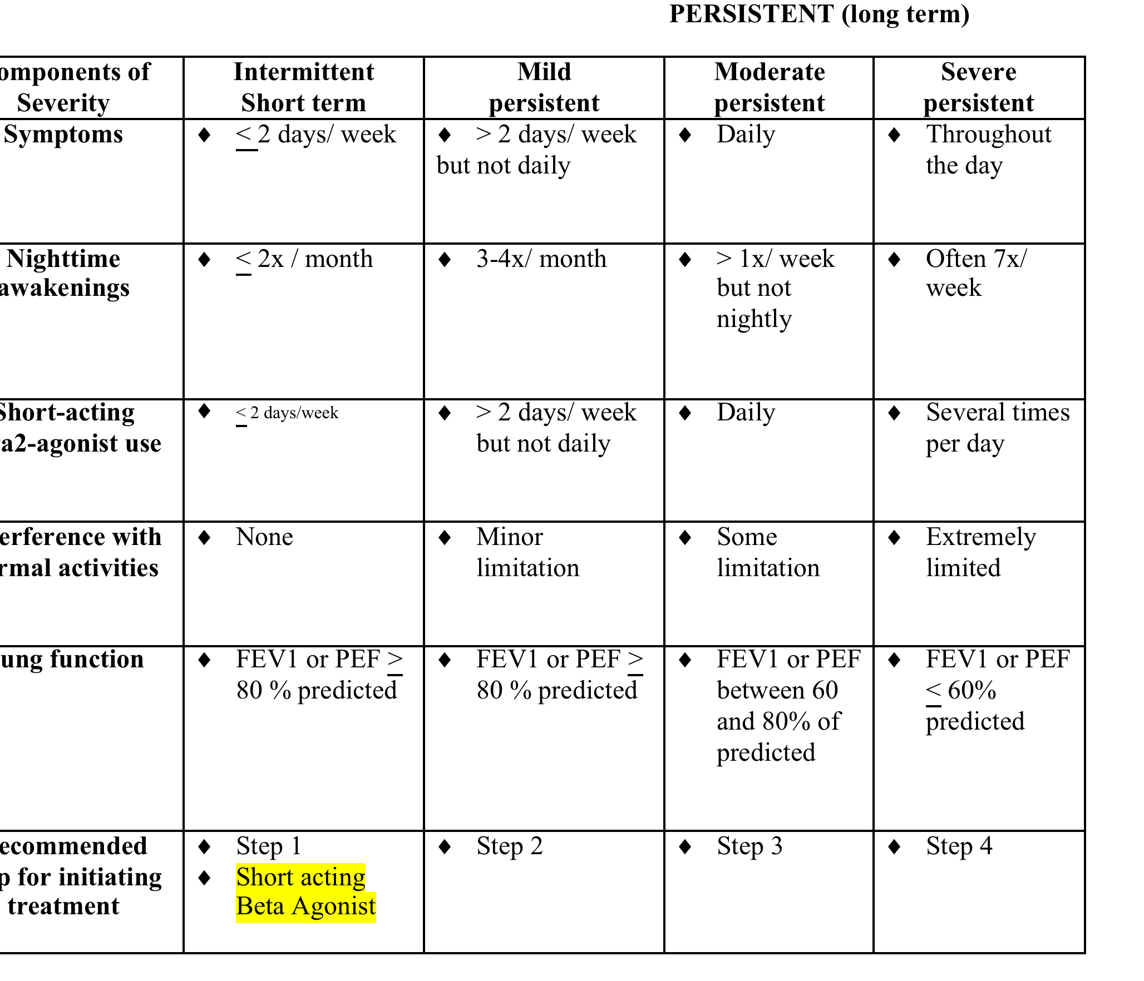
Classification of Long Term Asthma

